Slide 1

Notes:
Introduce yourself and the project: an AI news research tool for equity research analysts. It takes one query, fetches the latest news and produces a short summary with a sentiment label. Built with LangChain, OpenAI, NewsAPI and Streamlit.

Slide 2
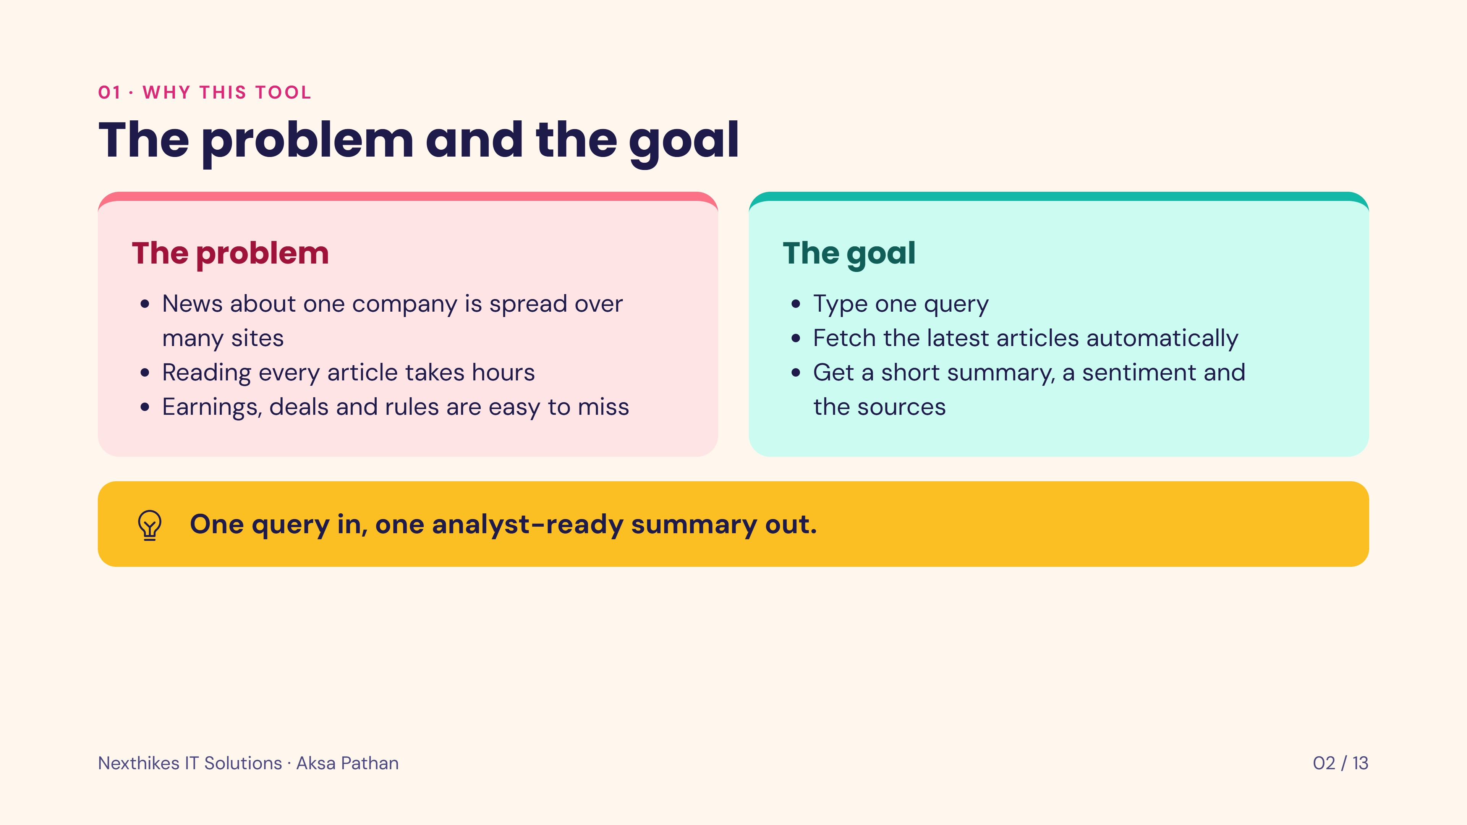
Notes:
Equity research analysts follow many companies. News is scattered and slow to read. The tool takes a query, collects the latest articles and returns a short, source-backed summary so the analyst can decide quickly what matters.

Slide 3
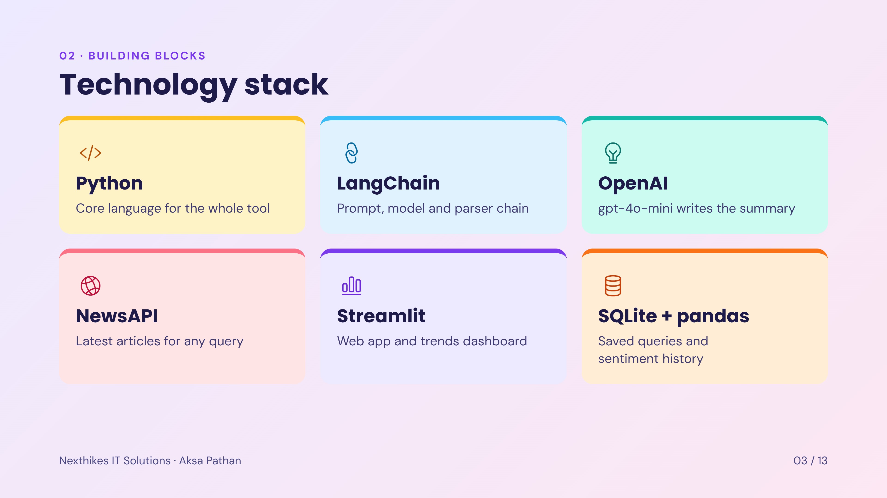
Notes:
Six building blocks: Python as the language, LangChain to connect prompt and model, OpenAI gpt-4o-mini for the summary, NewsAPI for articles, Streamlit for the web interface and dashboard, and SQLite with pandas for saved queries and trends.

Slide 4
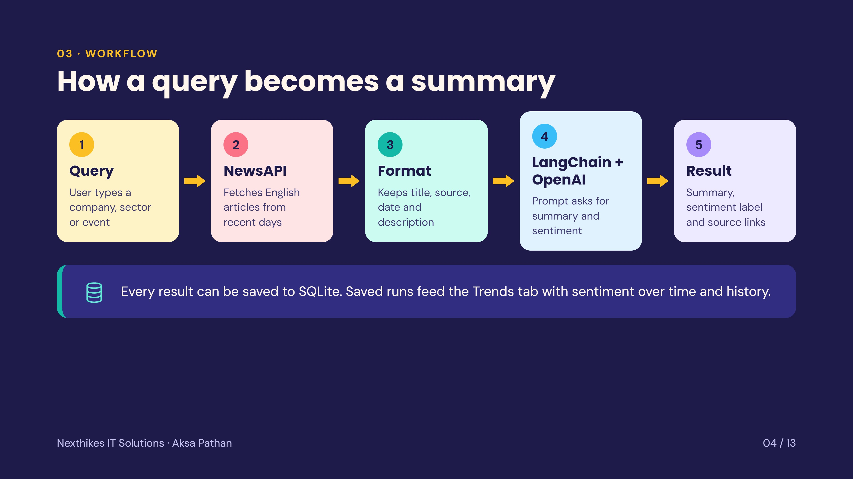
Notes:
Walk the five steps left to right. The user query goes to NewsAPI, the articles are formatted with source and date, LangChain builds the prompt for OpenAI, and the app shows the summary, the sentiment label and the source links. Results can be saved and then appear in the Trends tab.

Slide 5
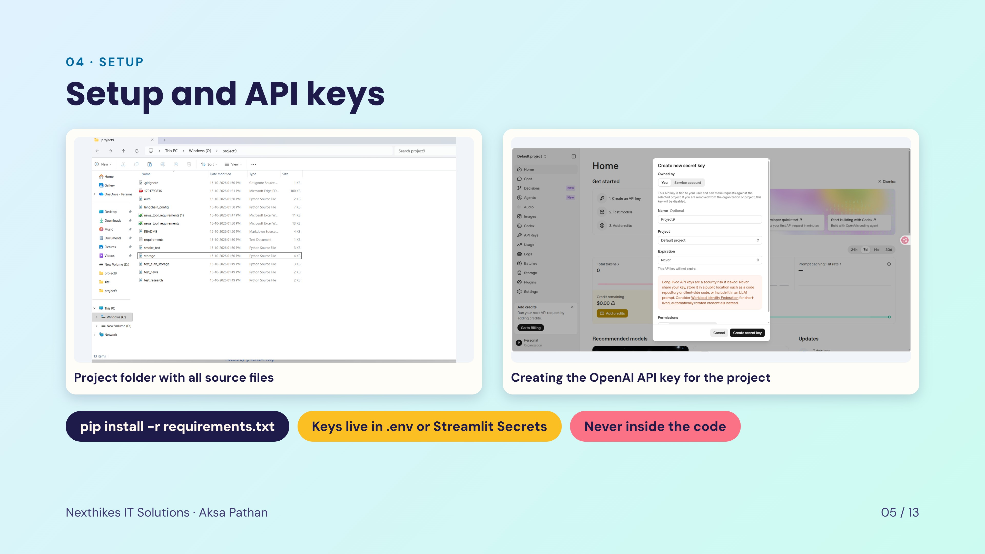
Notes:
Setup has two parts. First install the libraries from requirements.txt. Second create an OpenAI key and a NewsAPI key. The keys are stored in a .env file locally and in Streamlit Secrets when deployed, never in the source code or on GitHub.

Slide 6
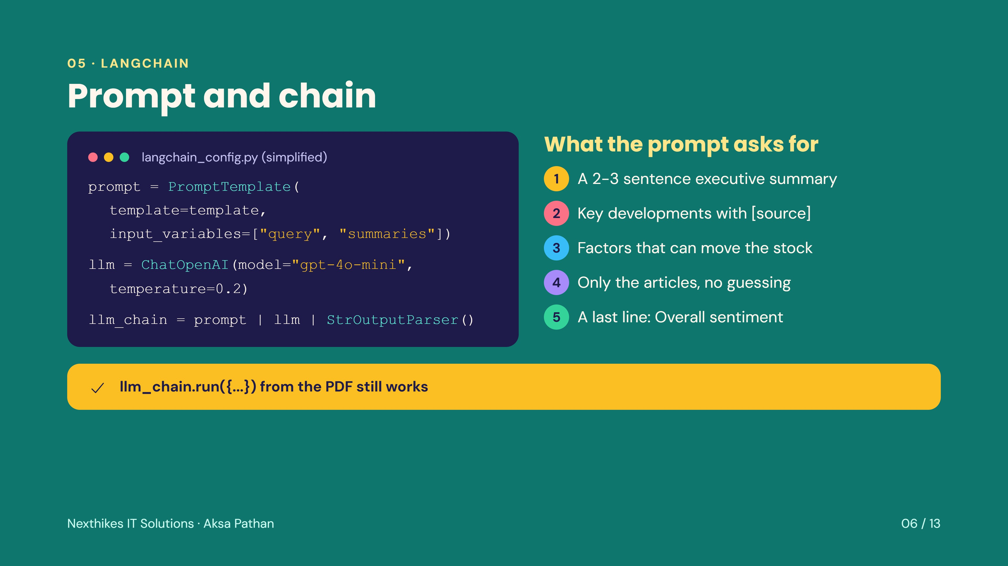
Notes:
The prompt template has two inputs, the query and the article summaries. The chain is prompt, then the OpenAI model, then a string parser. The prompt tells the model to write an executive summary, list key developments with sources, mention factors that can move the stock, use only the articles and end with one sentiment line. A small wrapper keeps the PDF style llm_chain.run call working.

Slide 7
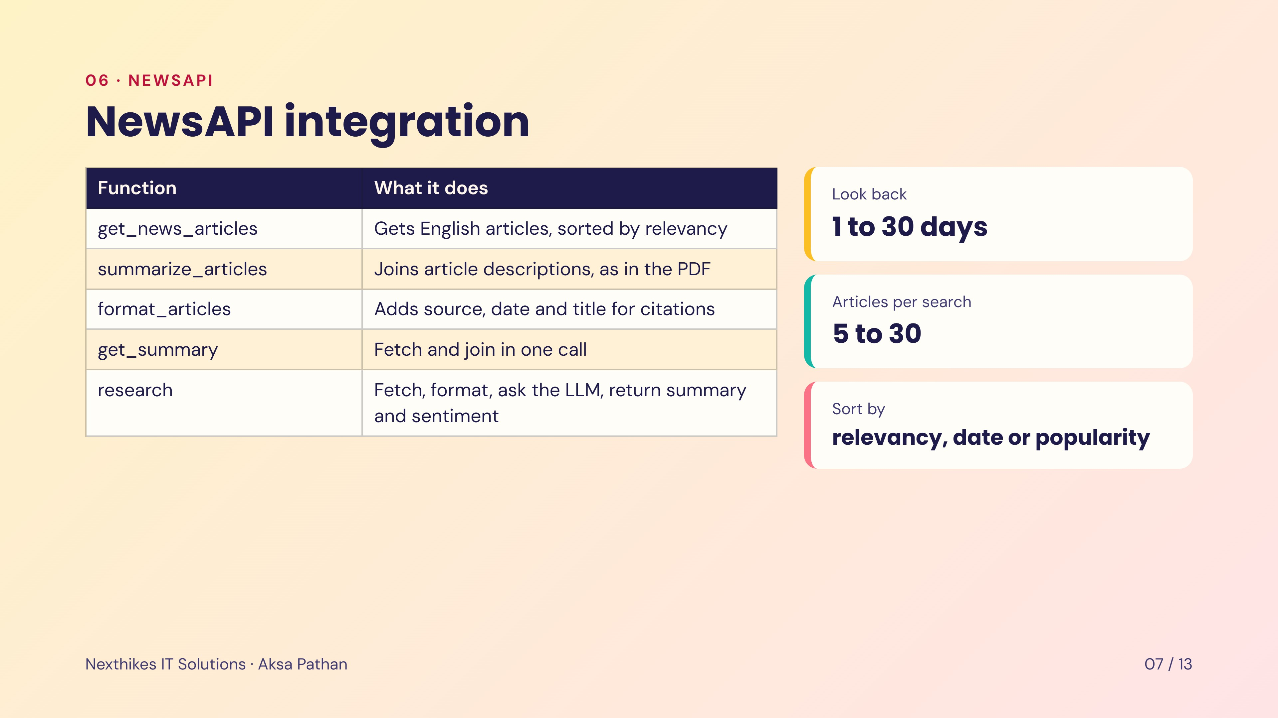
Notes:
These are the functions from the project PDF plus two helpers. get_news_articles calls NewsAPI, summarize_articles and get_summary follow the PDF, format_articles adds source and date so the summary can cite sources, and research runs the whole pipeline. In the app the user can choose the look-back window, the number of articles and the sort order. The free Developer plan covers about the last 30 days.

Slide 8
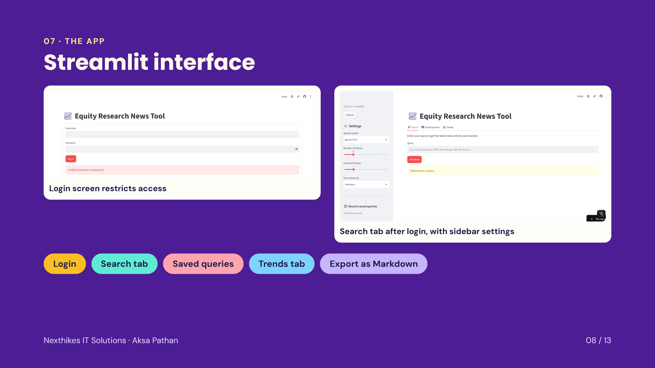
Notes:
Left is the login screen: only people with the username and password can use the tool and the API keys. Right is the main Search tab after login. The sidebar lets the user pick the OpenAI model, the number of articles, the look-back days and the sort order. There are three tabs: Search, Saved queries and Trends.

Slide 9
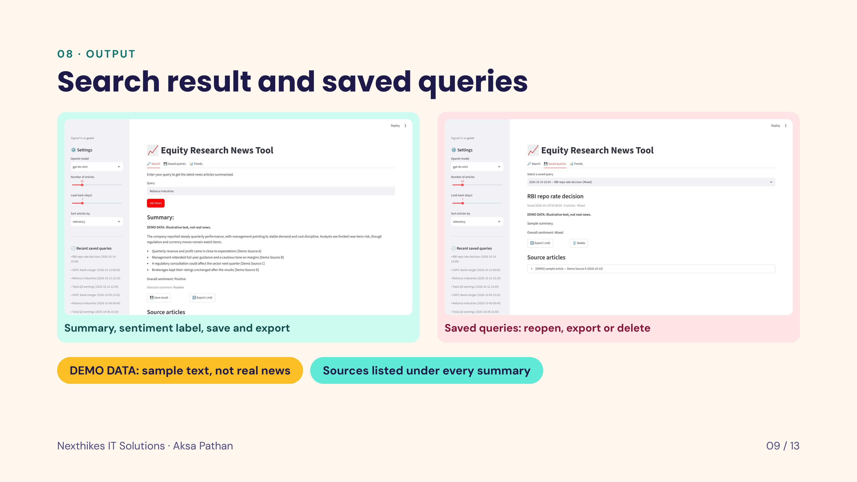
Notes:
These screens use demo data so that no real news is invented; the text is labelled DEMO DATA. On the left, a search returns an executive summary, bullet points with sources, the detected sentiment and buttons to save or export the result. On the right, saved results can be reopened, exported as Markdown or deleted.

Slide 10
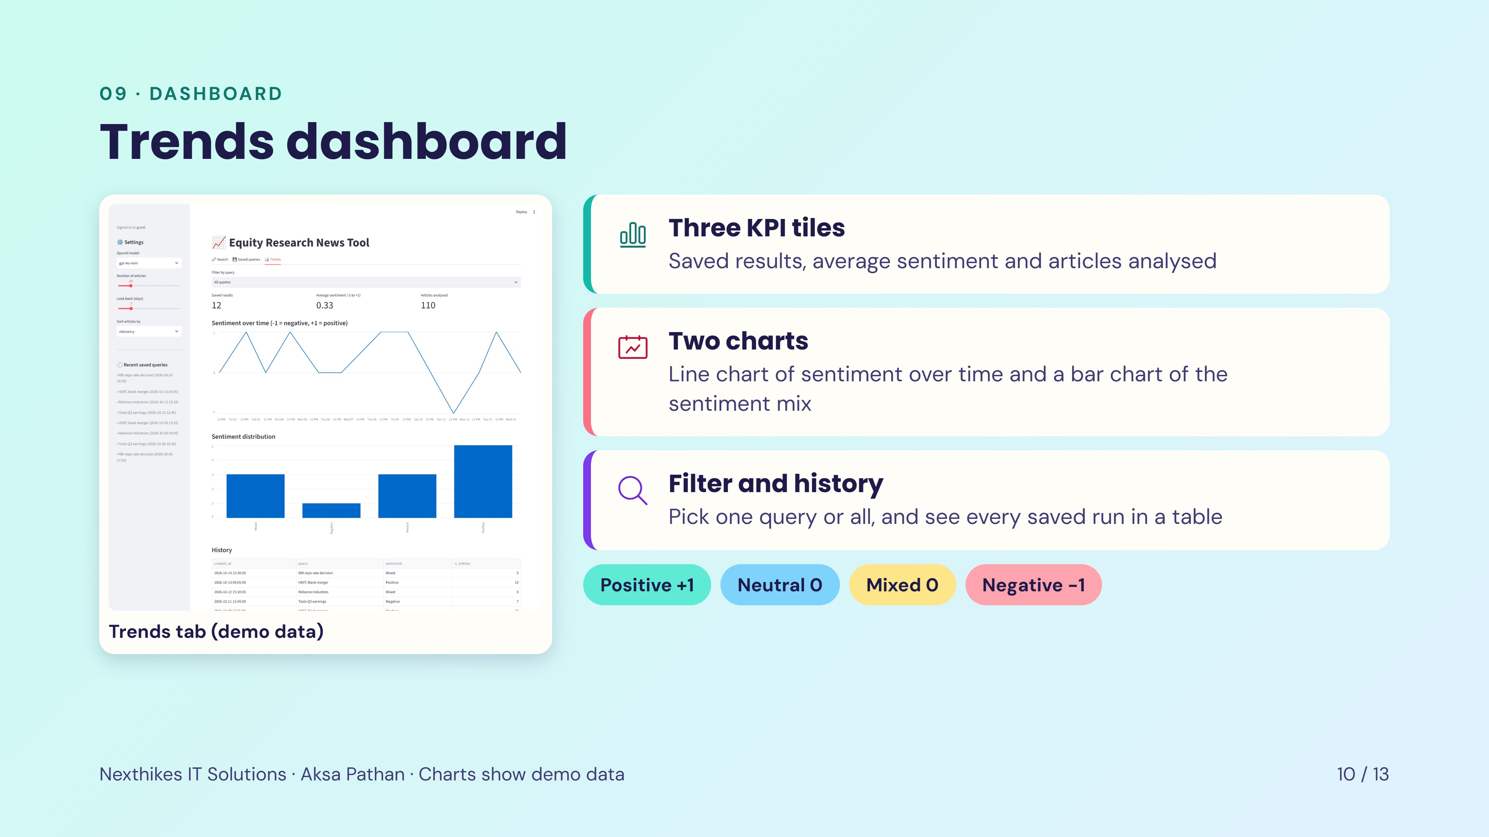
Notes:
The Trends tab turns saved results into a small dashboard. Each result gets a score: Positive is +1, Neutral and Mixed are 0 and Negative is -1. The line chart shows how sentiment moved over time, the bar chart shows how many results fell in each class, and the table lists every saved run. The data in this screenshot is demo data, created only to show the layout.

Slide 11
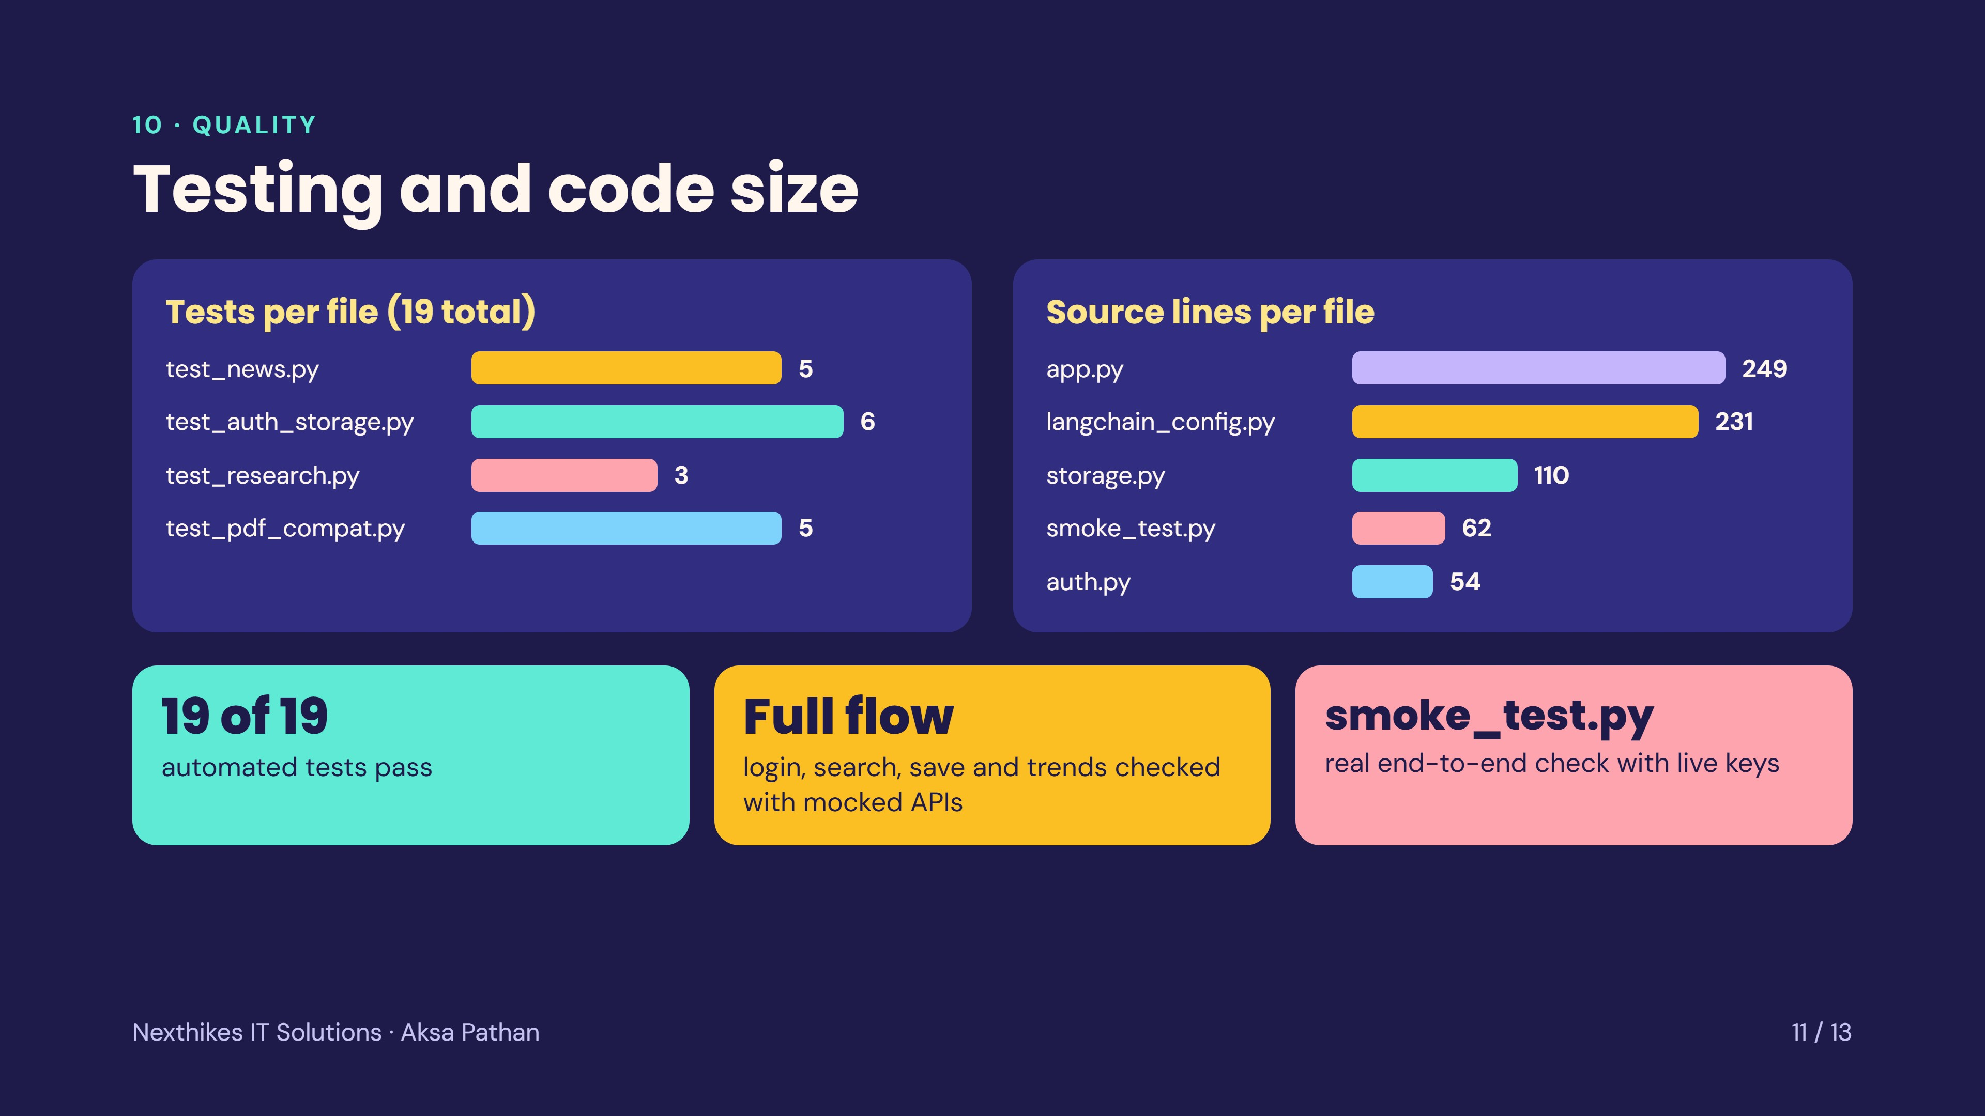
Notes:
The project has 19 automated tests across four files. They mock NewsAPI and OpenAI, so they need no keys. They cover the news helpers, the PDF-compatible names, sentiment extraction, login and saved queries. The app flow of login, search, save and trends was also tested with mocked APIs. For a real end-to-end check with live keys there is smoke_test.py, which prints the summary next to the source articles so the analyst can judge accuracy. Source code is about 700 lines.

Slide 12
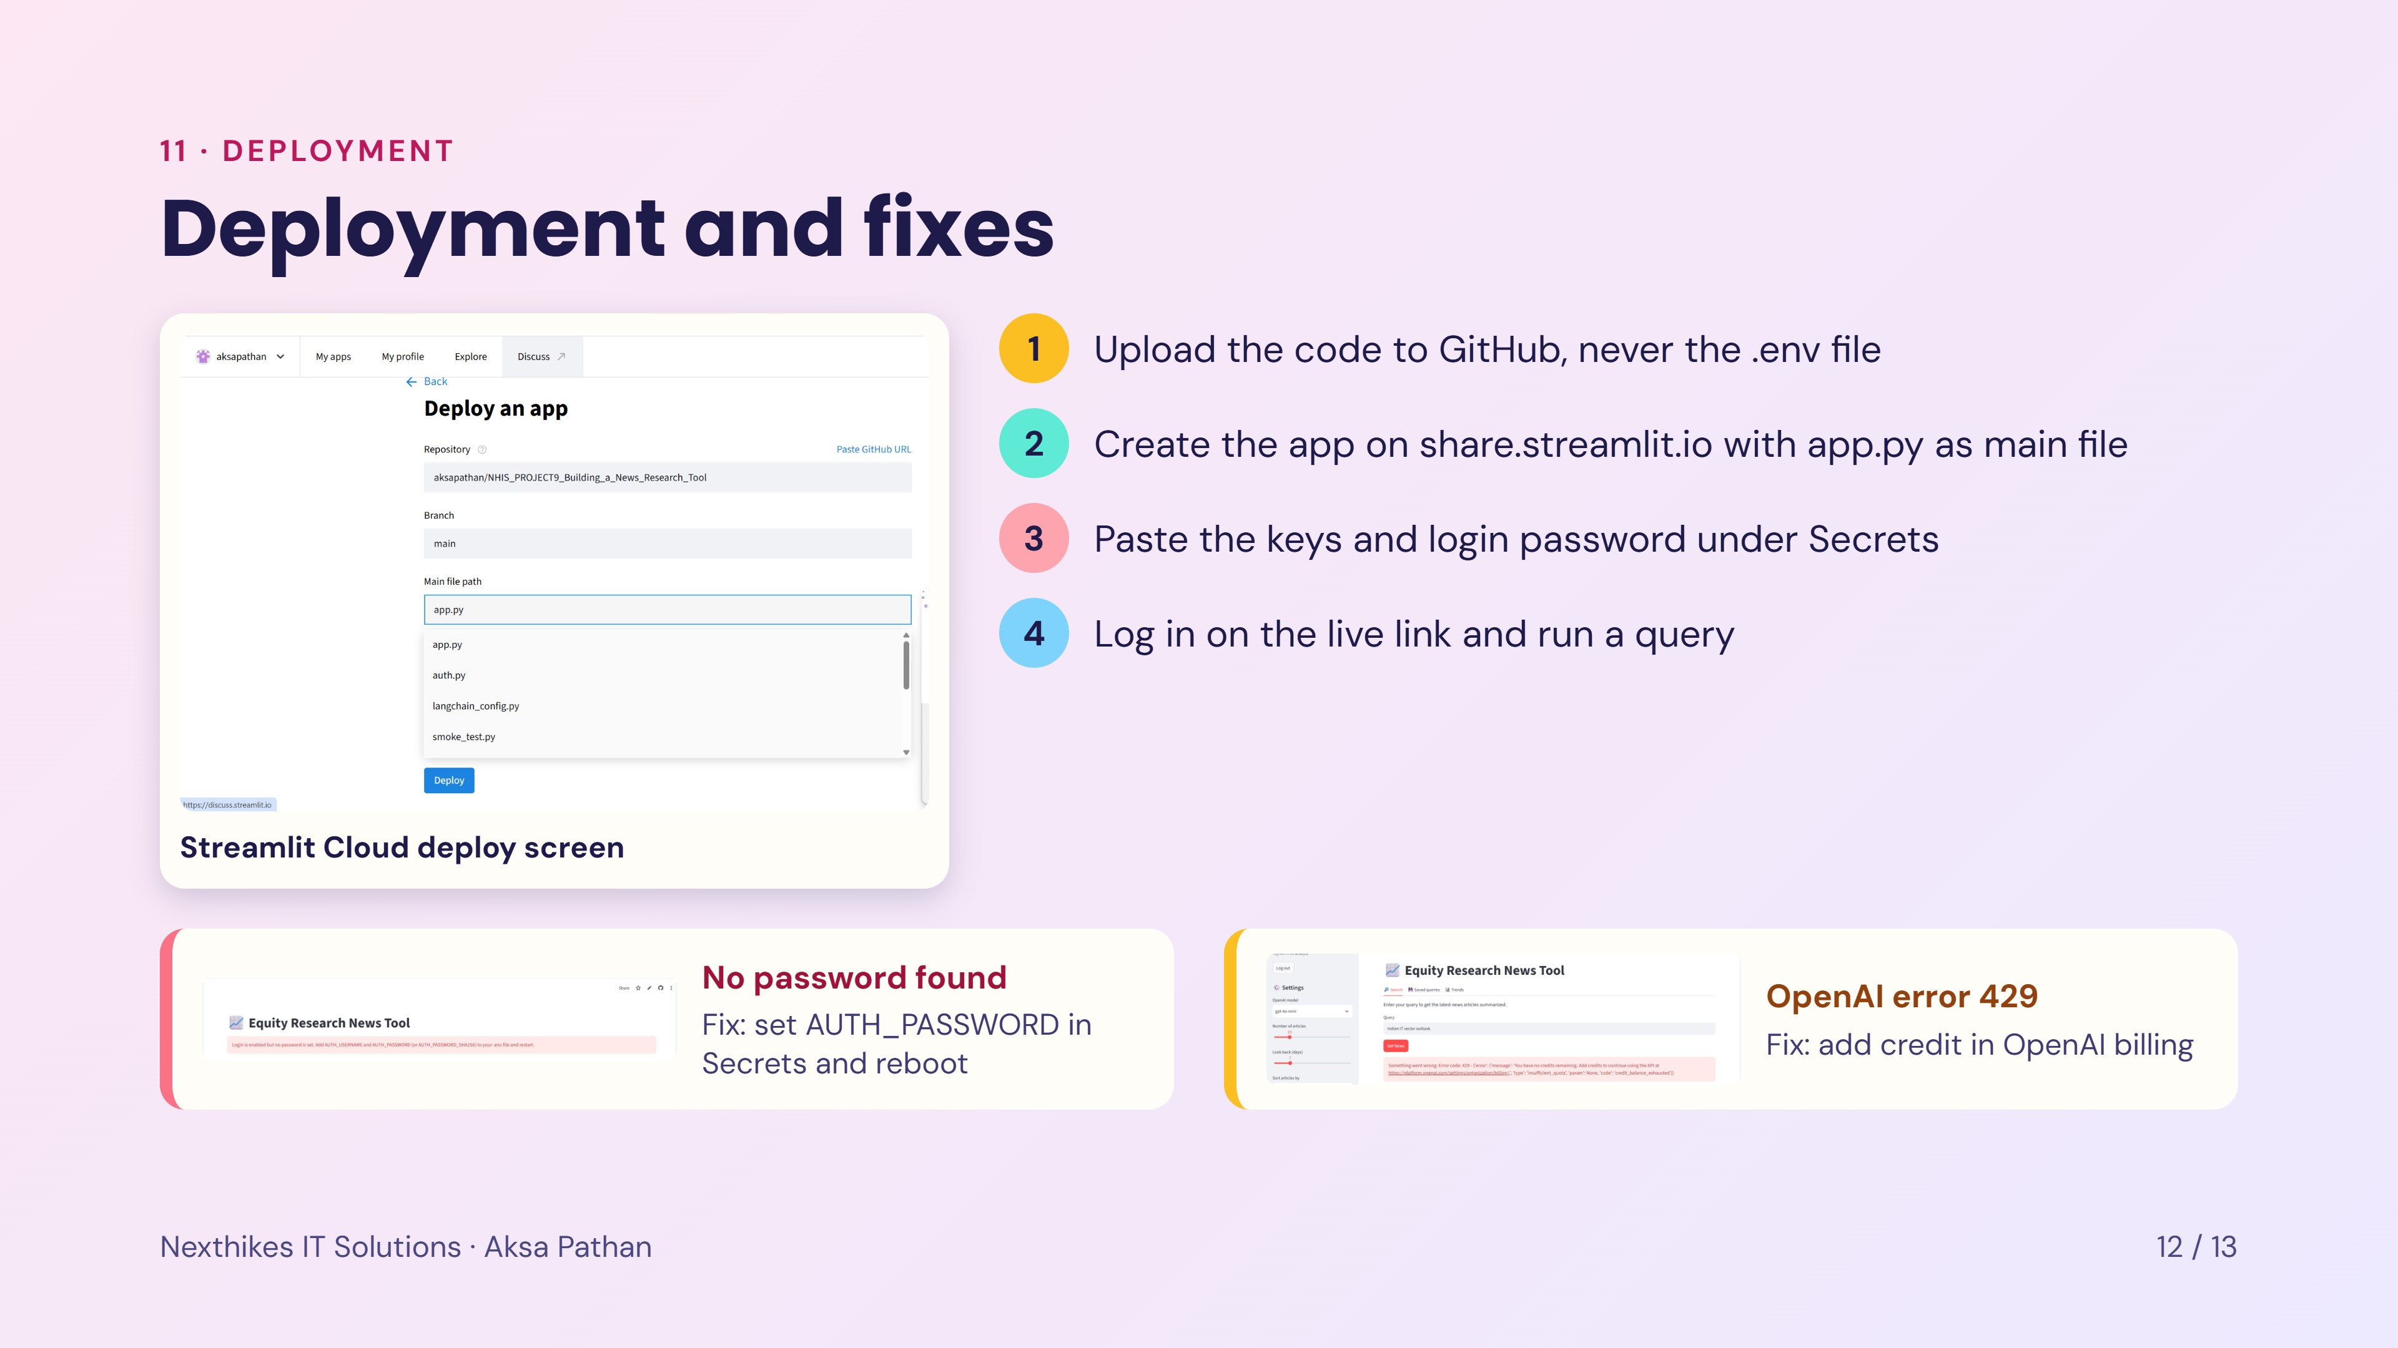
Notes:
Deployment uses GitHub and Streamlit Community Cloud. The code goes to GitHub without the .env file. On the deploy screen choose the repository, the main branch and app.py, then paste the keys and the login password under Secrets. Two issues came up during deployment. First, the app showed that no login password was found, which was fixed by adding the password in Secrets and rebooting. Second, OpenAI returned error 429 because the account had no credit, which is fixed by adding credit in the OpenAI billing page.

Slide 13
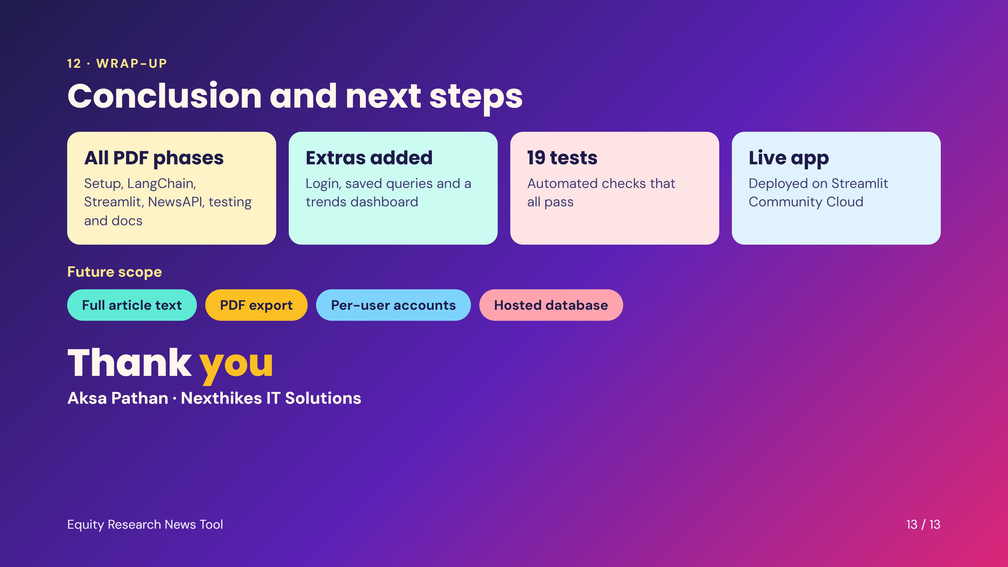
Notes:
Summary: every phase of the project PDF is implemented, and the tool also has login, saved queries and a trends dashboard. There are 19 automated tests and the app is deployed on Streamlit Community Cloud. Possible next steps are using full article text, PDF export, per-user accounts and a hosted database so that saved queries survive restarts. Thank the audience.

